Slide 1

Gases

Slide 2

Introducing gases
Air is a mixture of many substances:
Nitrogen, oxygen, argon and carbon dioxide.
Other substances are present in parts per million (ppm) by volume.

Slide 3
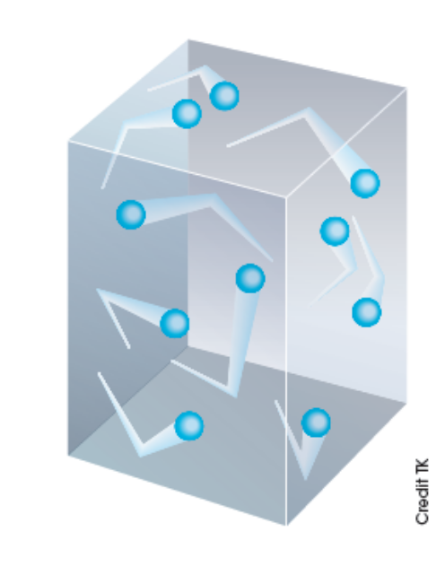
Gas pressure
Gas particles are far apart, in constant random motion, collide and exert pressure.
Gas pressure is a measure of the force per unit area.

Slide 4
The SI unit of gas pressure is the pascal (Pa) and is equivalent to a force of 1 newton per square metre.
The pressure due to the atmosphere is called atmospheric pressure.
This unit of standard atmospheric pressure at sea level 1.00 x 10⁵ Pa or 100kPa (kilopascals).

Slide 5
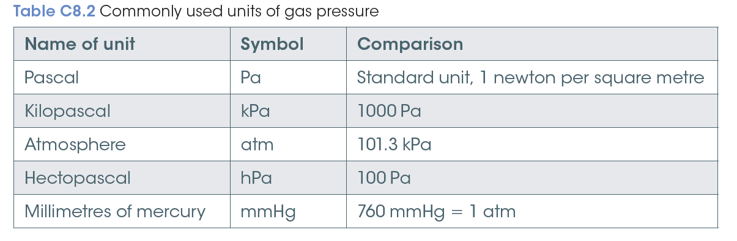

Slide 6
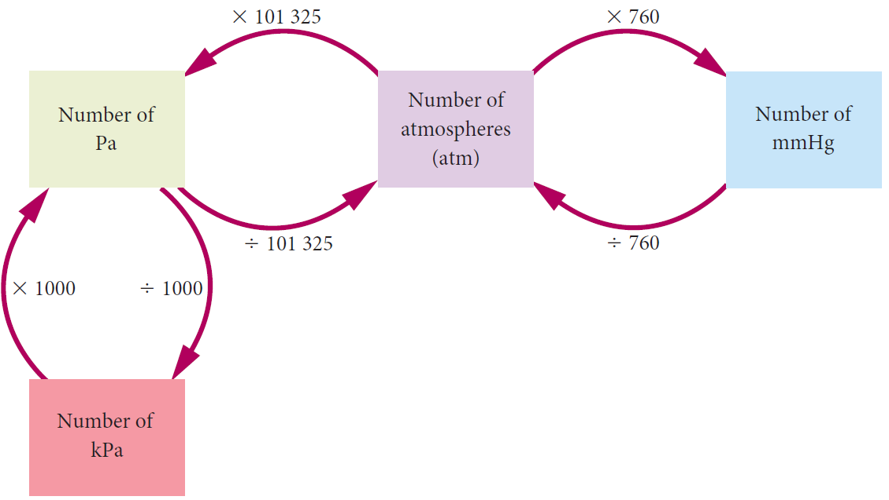
Converting between units

Slide 7
Kinetic theory of gases
The kinetic theory of gases proposes that:
Gases consist of molecules (except the noble gases, which consist of atoms) that move in continual random straight-line motion.
The average distance between gas molecules is very large compared to the size of the molecule.
Intermolecular forces between molecules are negligible.

Slide 8
All collisions of gas molecules are perfectly elastic collisions, which means there is no net energy loss during these collisions.
Pressure is due to collisions of the molecules with the walls of the container.
Temperature is a measure of the average kinetic energy of the molecules.

Slide 9
Considering temperature
The kinetic theory states that temperature is a measure of average kinetic energy.
At a given temperature, molecules of all gases, no matter what size, shape or mass, have the same average kinetic energy:
Kinetic energy = ½ mv²
where m is the mass and v is the speed.
.

Slide 10
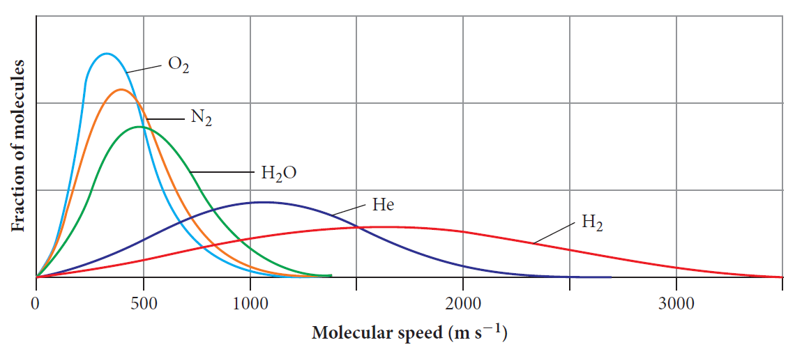
Kinetic energy is determined by both mass and speed.
Heavier gases will have lower speeds than lighter gases at the same temperature.

Slide 11
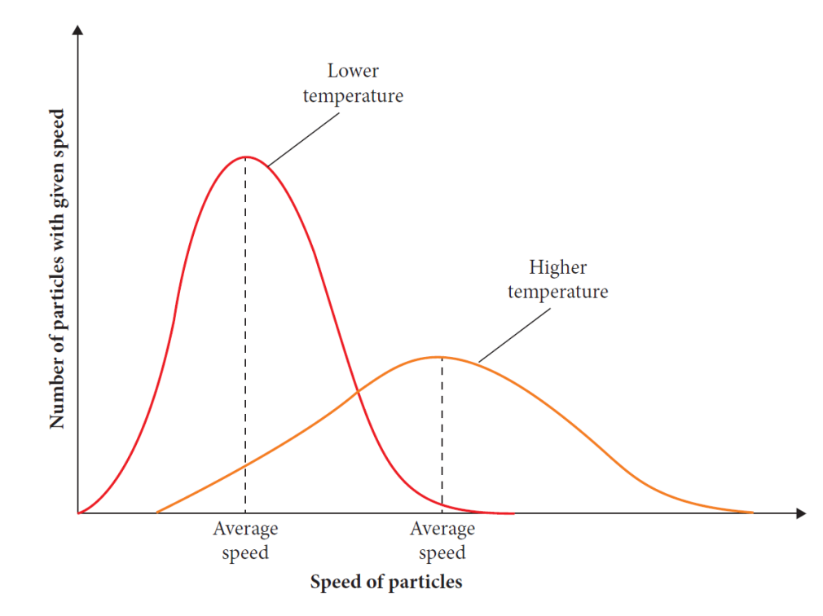
As the temperature increases, the kinetic energy of the particles increases, and vice versa.
Gas particles have a range of speeds at any given temperature
The average speed increases as temperature increases

Slide 12
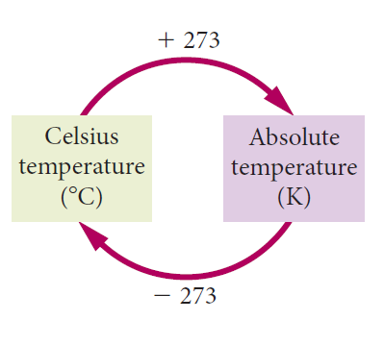
Absolute (kelvin) temperature scale
The absolute temperature is a measure of the average kinetic energy of its molecules.

Slide 13
Gases diffuse
because gas particles have rapid, random motion and a lot of empty space between them so they quickly spread and mix.
Gases can be easily compressed
because there is a lot of empty space between particles.

Slide 14
Gases spread to fill a container
because there are negligible forces between particles.
Gases exert pressure
because the particles move rapidly and collide with the surface of any container or object.
Gases have low density
because there is a lot of empty space between them.

Slide 15
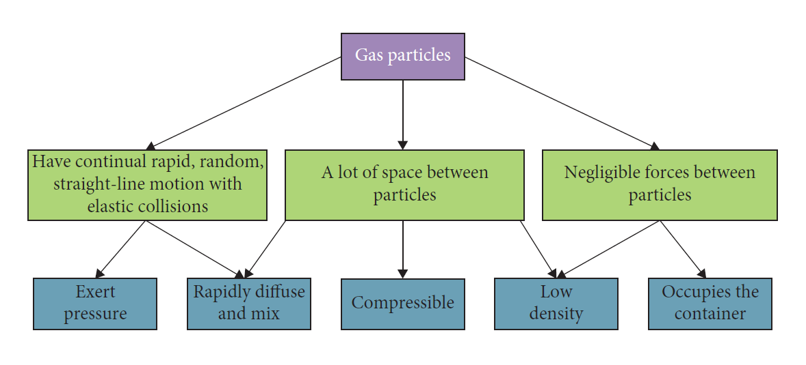
Explains the physical behaviour of gases

Slide 16
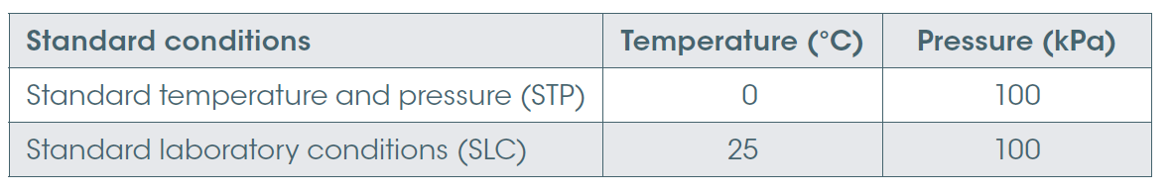
Gas laws
Standard conditions are used to compare changes in conditions that involve gases.
STP at 0ºC and 100KPa
SLC at 25ºC and 100KPa

Slide 17
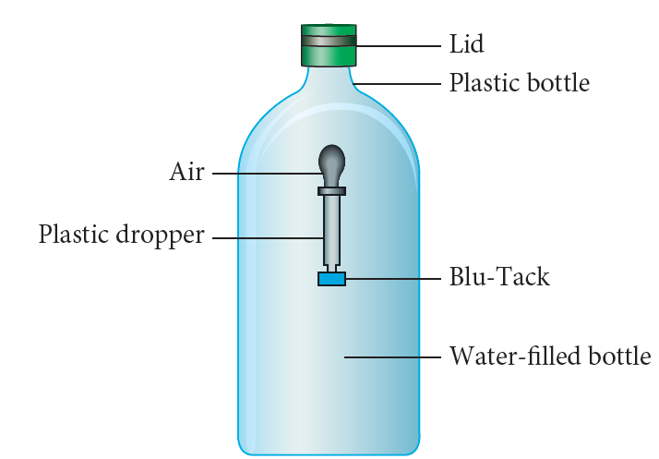
Boyle’s law
At a constant temperature, the volume of a given mass of gas is inversely proportional to the volume.
The larger the pressure, the smaller the volume.
P₁V₁ = P₂V₂
The units for P₁, P₂ pressure
and V_{1,} V₂ volume must be consistent.

Slide 18
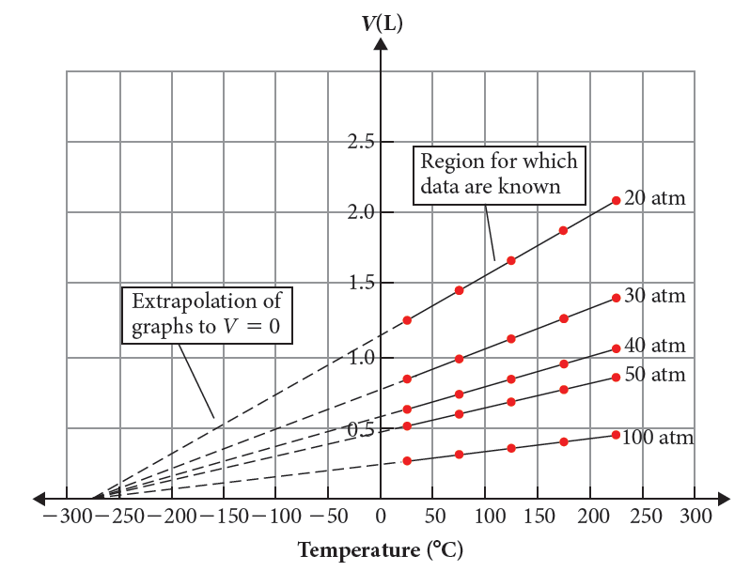
Charles’ law
Charles’ law states that at constant pressure, the volume of a fixed quantity of gas is proportional to its absolute (kelvin) temperature.

Slide 19
Combined gas laws
a relationship between volume, pressure and absolute temperature for a given mass of gas
P₁V₁ = P₂V₂
T₁ T₂
Combining Charles and Boyles laws, as temperature and pressure usually change together.

Slide 20
Avogadro’s hypothesis and molar volumes
Avogadro’s hypothesis states that equal volume of any gas, measure at the same temperature and pressure contain the same number of particles.
Molar volume of a gas = 22.7 L
Standard temperature and pressure
(0ºC and 100 kPa)

Slide 21
General gas equation
the relationship between pressure, temperature, volume and number of moles of a gas.
PV = nRT
where P is pressure in kPa
V is volume in L
n is total number of moles of gas present
R is the universal gas constant 8.31 J K^{–1} mol^{–1}
T is temperature in K

Slide 22
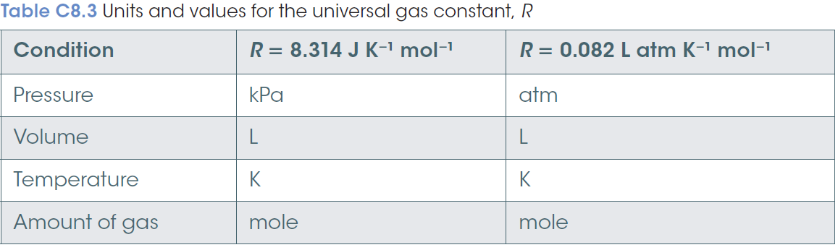

Slide 23
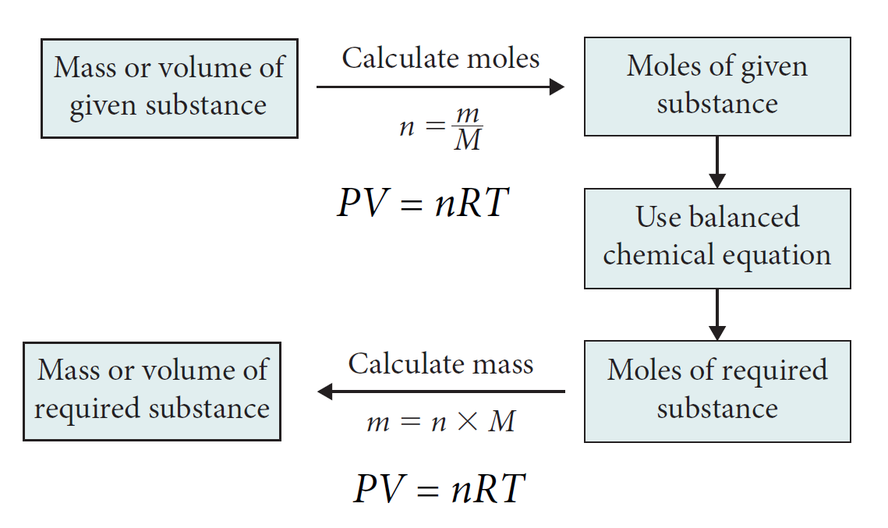
Calculating gases in chemical reactions

